Slide 1

ARRAYS in JAVA

Slide 2
ARRAYS:
An array is a collection of similar type of elements which has a contiguous memory location.
Java array is an object which contains elements of a similar data type.
Additionally, The elements of an array are stored in a contiguous memory location.
We can store only a fixed set of elements in a Java array.
Array in Java is index-based, the first element of the array is stored at the 0th index, 2nd element is stored on 1st index, and so on.
There are two types of arrays.
Single Dimensional Array
Multidimensional Array

Slide 3
SINGLE DIMENSIONAL ARRAY

Slide 4
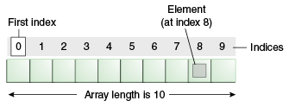
Single Dimensional Array in Java
Declaration:
Syntax : dataType[] arr; (or) dataType []arr; (or) dataType arr[];
Ex: int[] arr; or int []arr; int arr[];
Instantiation:
Syntax: arrayRefVar=new datatype[size];
Ex: arr = new int[10];
Declaration and Instantiation :
Syntax: datatype arrayRefVar[] = new datatype[size];
Ex: int arr[] = new int[10];

Slide 5
Single Dimensional Array in Java
Initialization:
int a[]=new int[5];//declaration and instantiation
a[0]=10;//initialization
a[1]=20;
a[2]=70;
a[3]=40;
a[4]=50;
Or
int a[]={10,20,70,40,50}; //declaration, instantiation and initialization

Slide 6
Single Dimensional Array in Java
Example :
class program1
{
public static void main(String args[])
{
//declaration, instantiation and initialization
int a[]={10,20,70,40,50};
//printing array
for(int i=0;i<a.length;i++)
System.out.println(a[i]);
}
}
Output:
10
20
70
40
50

Slide 7
Single Dimensional Array in Java
For-each Loop for Java Array
We can also print the Java array using for-each loop.
The Java for-each loop prints the array elements one by one.
It holds an array element in a variable, then executes the body of the loop.
Syntax:
for(data_type variable:array)
{
//body of the loop
}
Example:
class program2
{
public static void main(String args[])
{
int arr[]={10,20,70,40,50};
for(int i:arr)
System.out.println(i);
}
}

Slide 8
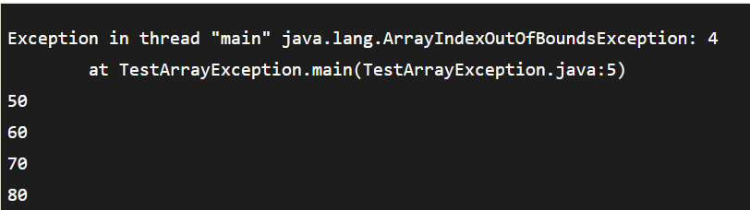
Single Dimensional Array in Java
ArrayIndexOutOfBoundsException
The Java Virtual Machine (JVM) throws an ArrayIndexOutOfBoundsException if the length of the array is negative, equal to the array size, or greater than the array size while traversing the array.
Example:
public class TestArrayException
{
public static void main(String args[])
{
int arr[]={50,60,70,80};
for(int i=0;i<=arr.length;i++)
System.out.println(arr[i]);
}
}
Output:

Slide 9
Single Dimensional Array in Java
Passing Array to a Method in Java
We can pass the java array to a method so that we can reuse the same logic on any array.
Let's see the simple example to get the minimum number of an array using a method.
Example: // Smallest value among the array
class program3
{
static void min(int arr[])
{
int min=arr[0];
for(int i=1;i<arr.length;i++)
{
if(min>arr[i])
min=arr[i];
}
System.out.println("Minimum value is " + min);
}
public static void main(String args[])
{
int a[]={40,20,10,30};
min(a);//calling min() method by passing array
}
}
Output:
Minimum value is 10

Slide 10
Single Dimensional Array in Java
Anonymous Array in Java
Java supports the feature of an anonymous array, so you don't need to declare the array while passing an array to the method.
Example:
public class program4
{
//creating a method that receives an array as a parameter
static void printArray(int arr[])
{
for(int i=0;i<arr.length;i++)
System.out.println(arr[i]);
}
public static void main(String args[])
{
//passing anonymous array to method
printArray(new int[]{10,22,44,66});
}
}
Output:
10
22
44
66

Slide 11
Single Dimensional Array in Java
Java Copy Array
In Java, we can copy one array into another. There are several techniques you can use to copy arrays in Java.
1. Copying Arrays Using Assignment Operator ( Shallow Copy )
class arrcopy1
{
public static void main(String[] args)
{
int [] numbers = {1, 2, 3, 4, 5, 6};
int [] positiveNumbers = numbers; // copying arrays
for (int number: positiveNumbers)
{
System.out.print(number + ", ");
}
}
}
Output:
1,2,3,4,5,6
However, there is a problem with this technique. If we change elements of one array, corresponding elements of the other arrays also change.

Slide 12
Single Dimensional Array in Java
class arrcopy2
{
public static void main(String[] args)
{
int [] numbers = {1, 2, 3, 4, 5, 6};
int [] positiveNumbers = numbers; // copying arrays
numbers[0] = -1;
for (int number: positiveNumbers)
{
System.out.print(number + ", ");
}
}
}
Here, we can see that we have changed one value of the numbers array. When we print the positiveNumbers array, we can see that the same value is also changed.
It's because both arrays refer to the same array object. This is because of the shallow copy.
Now, to make new array objects while copying the arrays, we need deep copy rather than a shallow copy.
Output:
-1,2,3,4,5,6

Slide 13
Single Dimensional Array in Java
2. Copy Arrays Using Looping Construct (Deep Copy)
class arrcopy3
{
public static void main(String[] args)
{
int [] source = {1, 2, 3, 4, 5, 6};
int [] destination = new int[6];
// iterate and copy elements from source to destination
for (int i = 0; i < source.length; ++i)
{
destination[i] = source[i];
}
source[0]=-1; // modifying element of source array
for (int i = 0; i < destination.length; ++i)
{
System.out.println(destination[i]);
}
}
}
Output:
1,2,3,4,5,6

Slide 14
Single Dimensional Array in Java
3. Copying Arrays Using arraycopy() method
In Java, the System class contains a method named arraycopy() to copy arrays. This method is a better approach to copy arrays than the above two.
The arraycopy() method allows you to copy a specified portion of the source array to the destination array.
Syntax: arraycopy(Object src, int srcPos,Object dest, int destPos, int length)
Here,
src - source array you want to copy
srcPos - starting position (index) in the source array
dest - destination array where elements will be copied from the source
destPos - starting position (index) in the destination array
length - number of elements to copy

Slide 15
Single Dimensional Array in Java
import java.util.Arrays;
class arrcopy4
{
public static void main(String[] args)
{
int[] n1 = {2, 3, 12, 4, 12, -2};
// Creating n2 array of having length of n1 array
int[] n2 = new int[n1.length];
// Creating n3 array of having length 5
int[] n3 = new int[5];
// copying entire n1 array to n2
System.arraycopy(n1, 0, n2, 0, n1.length);
System.out.println("n2 = " + Arrays.toString(n2));
// copying elements from index 2 on n1 array - copying element to index 1 of n3 array
// 2 elements will be copied
System.arraycopy(n1, 2, n3, 1, 2);
System.out.println("n3 = " + Arrays.toString(n3));
}
}
Arrays.toString() is used to convert an array of any type to a human-readable string representation.
The method returns a string representation of the elements in the array, enclosed in square brackets ([]), with each element separated by commas and spaces.
Output:
n2 = [2, 3, 12, 4, 12, -2]
n3 = [0, 12, 4, 0, 0]

Slide 16
Programs on Single Dimensional Array
Write a program to read 5 numbers into an array and arrange them in ascending order.
Write a program to read 6 numbers into an array and print the duplicate numbers.
Write a program to find Second Largest Number in an Array.
Write a program to read n numbers into an array and find the sum of all the elements.
Write a program to copy one array into another array.

Slide 17
MULTI DIMENSIONAL ARRAY

Slide 18
Multidimensional Array in Java
Multi-dimensional Array ( 2 – D Array) :
Here, data is stored in a row and column-based index (also known as matrix form)..
Syntax to Declare Multidimensional Array in Java :
dataType[][] arrayRefVar; (or)
dataType [][]arrayRefVar; (or)
dataType arrayRefVar[][]; (or)
dataType []arrayRefVar[];
Example to instantiate Multidimensional Array in Java :
int[][] arr=new int[2][3];//2 rows and 3 columns
Example to initialize Multidimensional Array in Java :
int arr[][]={{10,20,30},{40,50,60}};

Slide 19
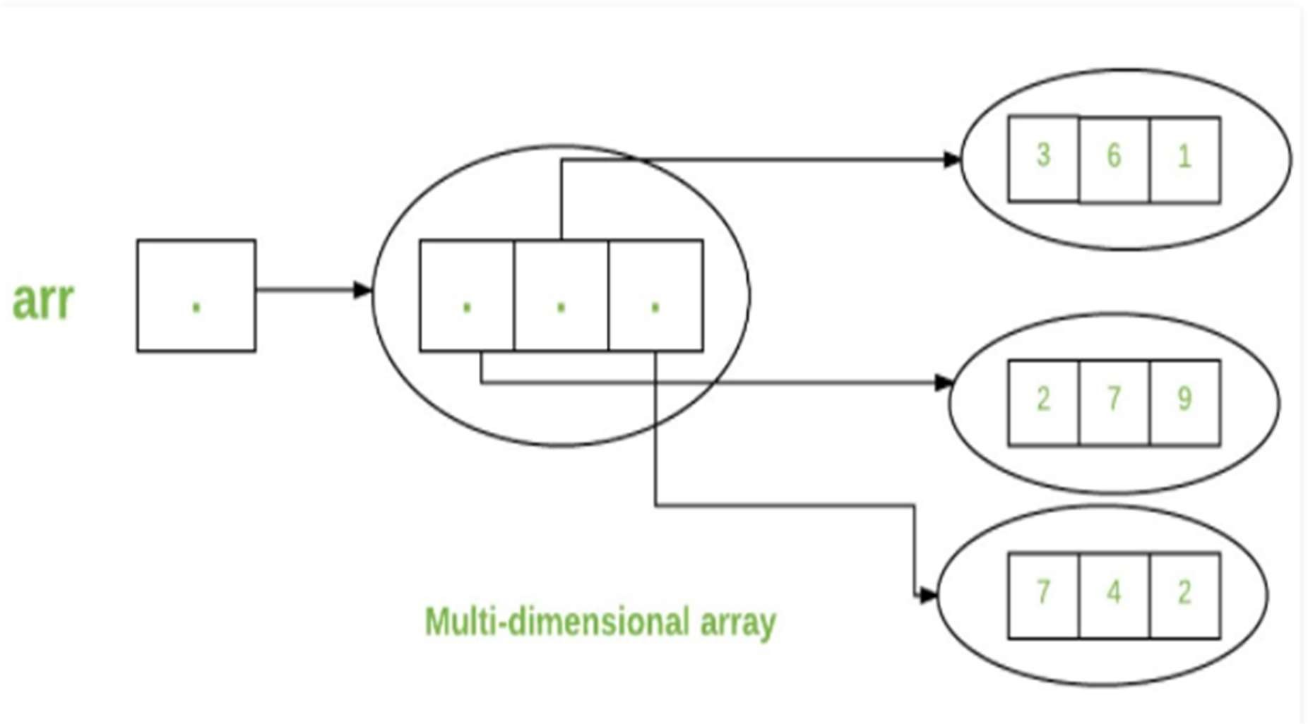
Multidimensional Array in Java
Multi-dimensional Array ( 2 – D Array) :
int arr[][] = { {2,7,9},{3,6,1},{7,4,2} };

Slide 20
Multidimensional Array in Java
Example of Multidimensional Java Array
Let's see the simple example to declare, instantiate, initialize and print the 2- Dimensional array.
Example:
class program6
{
public static void main(String args[])
{
//declaring and initializing 2D array
int arr[][]={{1,2,3},{2,4,5},{4,4,5}};
//printing 2D array
for(int i=0;i<3;i++)
{
for(int j=0;j<3;j++)
{
System.out.print(arr[i][j]+" ");
}
System.out.println();
}
}
}
Output:
2 3
4 5
4 4 5

Slide 21
Multidimensional Array in Java
Addition of two matrices :
class Testarray5
{
public static void main(String args[])
{
//creating two matrices
int a[][]={{1,3,4},{3,4,5}};
int b[][]={{1,3,4},{3,4,5}};
//creating another matrix to store the sum of two matrices
int c[][]=new int[2][3];
//adding and printing addition of 2 matrices
for(int i=0;i<2;i++)
{
for(int j=0;j<3;j++)
{
c[i][j]=a[i][j]+b[i][j];
System.out.print(c[i][j]+" ");
}
System.out.println();//new line
}
}
}
Output:
2 6 8
6 8 10

Slide 22
Multidimensional Array in Java
Jagged Array in Java
If we are creating odd number of columns in a 2D array, it is known as a jagged array.
In other words, it is an array of arrays with different numbers of columns.
Example:
class TestJaggedArray
{
public static void main(String[] args)
{
//declaring a 2D array with odd columns
int arr[][] = new int[3][];
arr[0] = new int[3];
arr[1] = new int[4];
arr[2] = new int[2];
//initializing a jagged array
int count = 0;
for (int i=0; i<arr.length; i++)
{
for(int j=0; j<arr[i].length; j++)
{
arr[i][j] = count++;
}
}
//printing the data of a jagged array
for (int i=0; i<arr.length; i++)
{
for (int j=0; j<arr[i].length; j++)
{
System.out.print(arr[i][j]+" ");
}
System.out.println();
}
}
}
Output:
0 1 2
3 4 5 6
7 8

Slide 23
Multidimensional Array in Java
Advantages of Jagged Array Over Multi-dimensional Array in Java
Jagged arrays have several advantages over multidimensional arrays with a fixed size:
Memory Efficiency: Jagged arrays are more memory-efficient than multidimensional arrays because they only allocate memory for the elements they need. In a multidimensional array with a fixed size, all the memory is allocated, even if some elements are unused.
Flexibility: Jagged arrays are more flexible than multidimensional arrays because they can have different sizes for each row. Jagged arrays enable the representation of non-rectangular or irregular data structures.
Easy to Initialize: Jagged arrays are easy to initialize because you can specify the size of each row individually. The suitability of jagged arrays lies in their ability to store data that varies in size or is generated dynamically.
Enhanced Performance: Jagged arrays can provide enhanced performance in certain scenarios, such as when you need to perform operations on each row independently or when you need to add or remove rows dynamically.

Slide 24
Thank You

